Slide 1
CS 201 – DATA STRUCTURES
LECTURE 22: QUEUES

Slide 2
Is memory being wasted?
Suppose we have queue which is full then we dequeue elements from the front. Now what if we want to add more elements?
Will they get added? Because the back pointer is pointing to last index already.
However after dequeuing we can add more elements at the indexes which are now free. But how?

Slide 3
Circular queue
A wrap around queue.

Slide 4
Priority queue
Examples: schedulers in OS
Give high priority to some task or object based on particular condition. For eg give priority to a task so that it gets printed before an entire book has to be printed

Slide 5
Options
Linked list
Problem? Complexity of O(N) to traverse min
Sorted list
Problem? Complexity of O(N) to insert
Binary search tree
Heap

Slide 6
Binary heap tree
binary tree of height h has between 2^{h} and 2^{h+1} − 1 nodes.

Slide 7
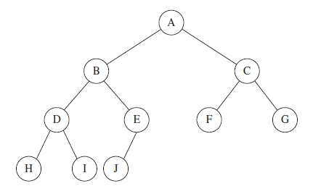

Slide 8
Representation
Represent the items in array from position 0.
The logic is that the left child will be in position 2i+1 and right child will be in position 2i+2
And the parent is in position i/2 (ceil) -1

Slide 9
Example
Consider case 2,8,6,1,10,15,3,12,11
Insertions will take O(log n)
Deletion (O(log n))
Heap sort has two main functions:
First to build a heap which means given a random array, arrange it into heap form (this taken O(nlogn))
Then extract max or min element, and again rearrange the heap (now size decreases by one). This operation takes O(logn) but as this process takes place n-1 times thereby overall complexity becomes O(nlogn)

